Slide 1
Attention Model in Deep Learning
2017. 11. 24
손한빈

Slide 2
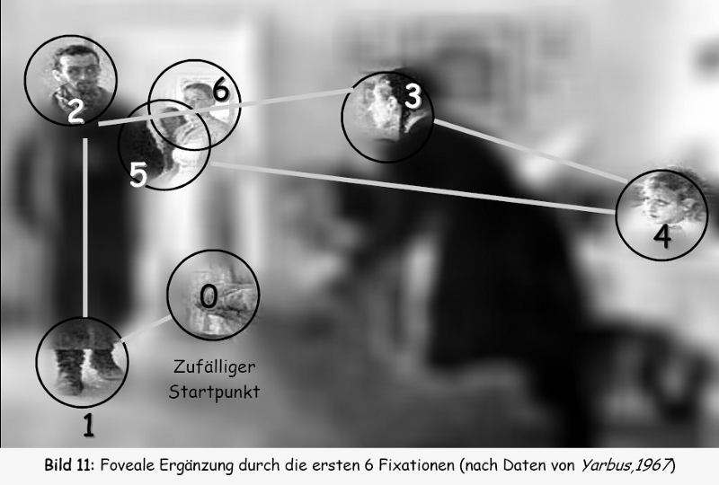
Attention?
Definition: focus on a certain region of an image with “high resolution” while perceiving the surrounding image in “low resolution”

Slide 3
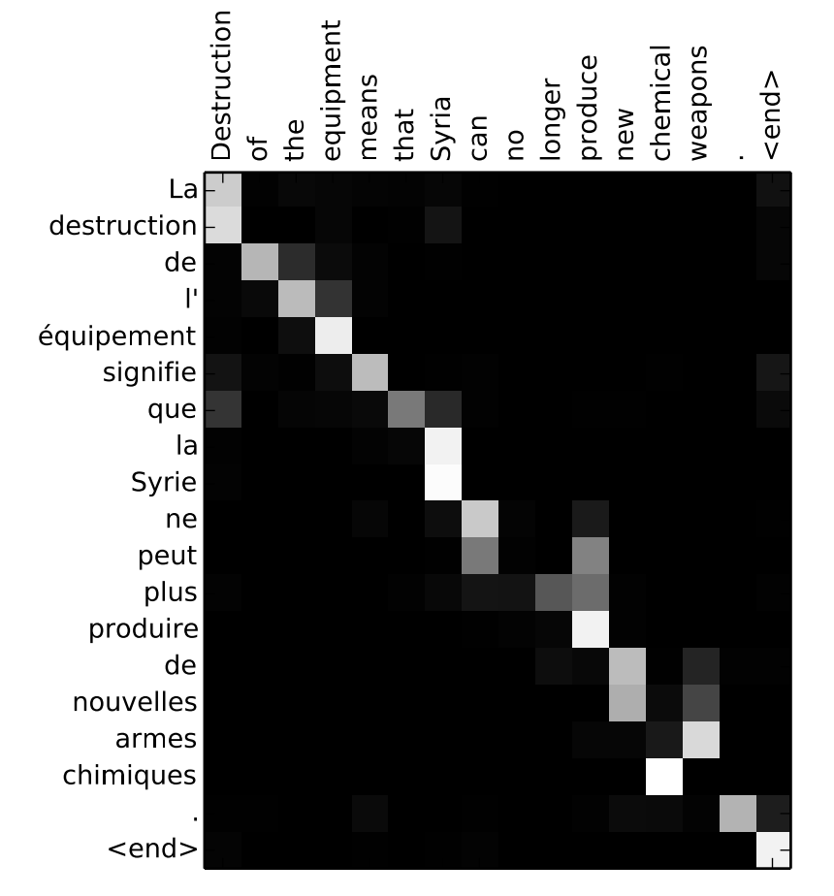
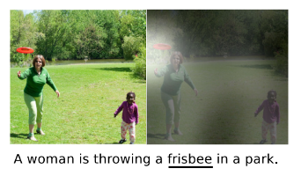
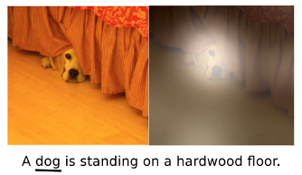
Attention?

Slide 4
Contents
RNN & LSTM
Machine Translation
Attention Model
Case Study

Slide 5

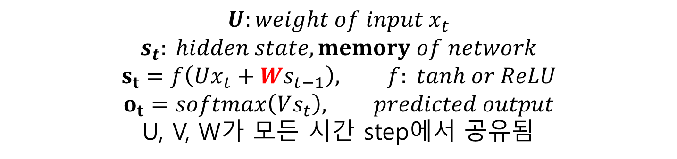
RNN & LSTM
$$U:weight of input x_{t}$$
$$s_{t}: hidden state, memory of network$$
$$s_{t}=f\left(Ux_{t}+Ws_{t−1}\right), f: tanh or ReLU$$
$$o_{t}=softmax\left(Vs_{t}\right), predicted output$$
U, V, W가 모든 시간 step에서 공유됨

Slide 6
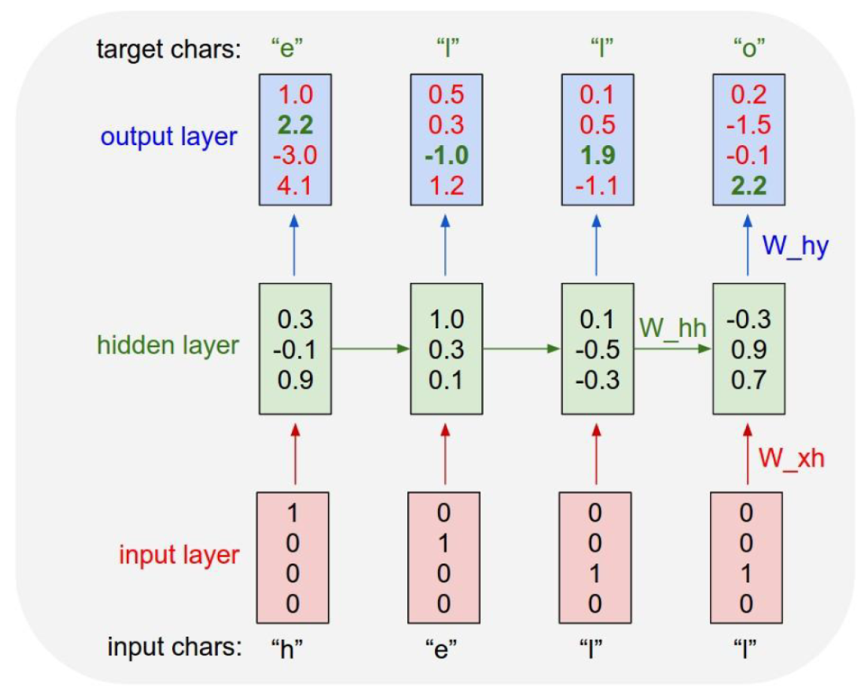
RNN & LSTM

Slide 7

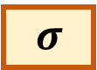
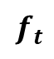
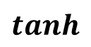
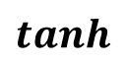
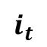
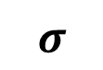
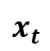
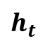
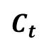
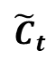
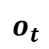
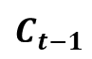
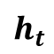
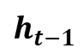
RNN & LSTM
$$h_{t}$$
$$C_{t−1}$$
$$C_{t}$$
$$tanh$$
$$o_{t}$$
$$f_{t}$$
$$i_{t}$$
$${\tilde{C}}_{t}$$
$$σ$$
$$tanh$$
$$h_{t−1}$$
$$h_{t}$$
$$x_{t}$$

Slide 8
RNN & LSTM
Why RNN?
ex) 다음 단어를 예측하는 Network
현재 Input만으로는 어려움
과거의 Input들을 활용하고 싶다
따라서 Memory를 추가한 것이 RNN (Memory = Hidden State)
즉, 현 시점의 Hidden State는 현재 RNN Process의 문맥 (Context)를 담고 있다고 볼 수 있다.

Slide 9
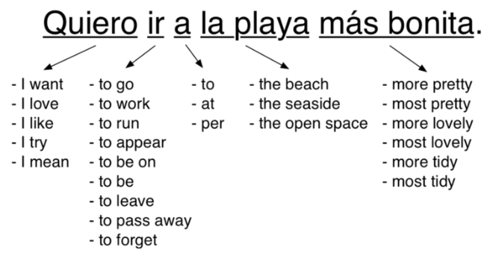
Machine Translation
Ruled based Machine Translation
두 언어 사이의 규칙을 기반으로 번역
언어 규칙에 예외사항이 매우 많아서 적용하기 까다로움
Statistical Machine Translation
언어와 언어의 관계를 확률 분포로 표현하여 번역
여러가지 뜻을 가진 한 단어를 주위 문맥을 통해 확률을 구해내어 번역
번역하고자 하는 새로운 언어 한 쌍 마다 새로운 가이드라인을 제시해야함

Slide 10
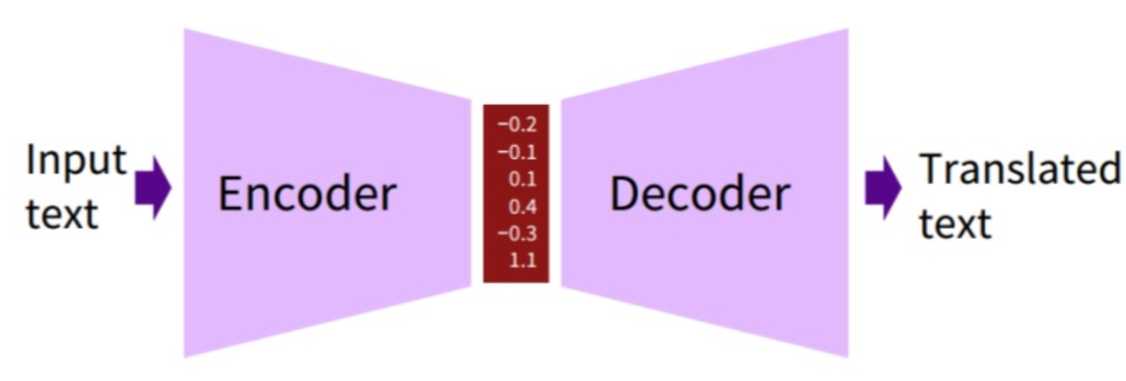
Machine Translation
Neural Machine Translation
Neural Network를 기반으로 Machine Translation 수행
사람의 개입 없이 두 언어 사이의 Translation 방법을 학습
RNN Encoder를 통해 언어의 특성을 잘 가지고 있는 Feature 추출하고 다시 Decoding하는 과정을 통해 Translation 수행

Slide 11
Machine Translation
Neural Machine Translation: Encoding
RNN
RNN
RNN
RNN
Sentence
Feature
Machine
Learning
is
Fun

Slide 12
Machine Translation
Neural Machine Translation: Decoding
Machine
RNN
RNN
RNN
RNN
RNN
Sentence
Feature
Machine
Learning
is
Fun

Slide 13
Machine Translation
Neural Machine Translation: Decoding
Learning
Machine
RNN
RNN
RNN
RNN
RNN
RNN
Sentence
Feature
Machine
Learning
is
Fun

Slide 14
Machine Translation
Neural Machine Translation: Decoding
is
Learning
Machine
RNN
RNN
RNN
RNN
RNN
RNN
RNN
Sentence
Feature
Machine
Learning
is
Fun

Slide 15
Machine Translation
Neural Machine Translation: Decoding
Fun
is
Learning
Machine
RNN
RNN
RNN
RNN
RNN
RNN
RNN
RNN
Sentence
Feature
Machine
Learning
is
Fun

Slide 16
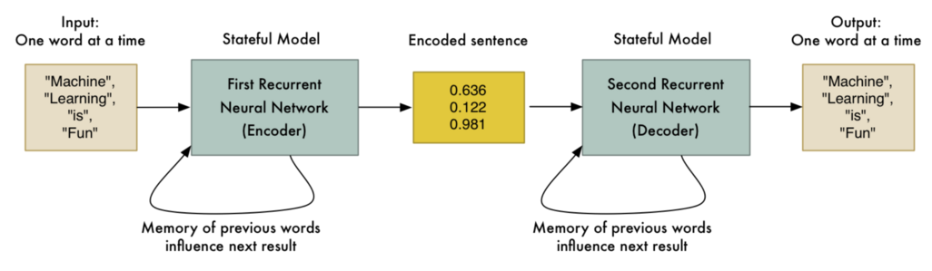
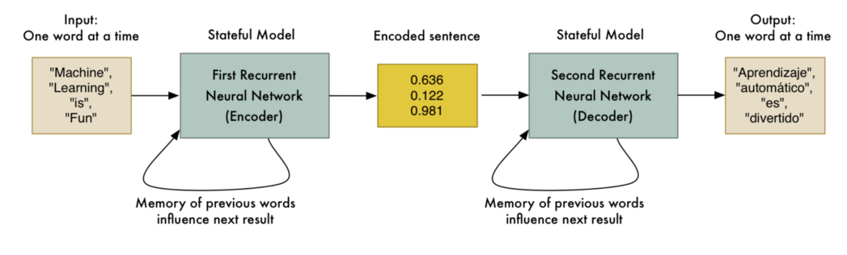
Machine Translation
English to English
English to Spanish

Slide 17
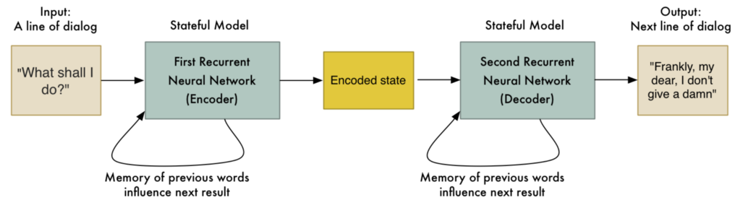
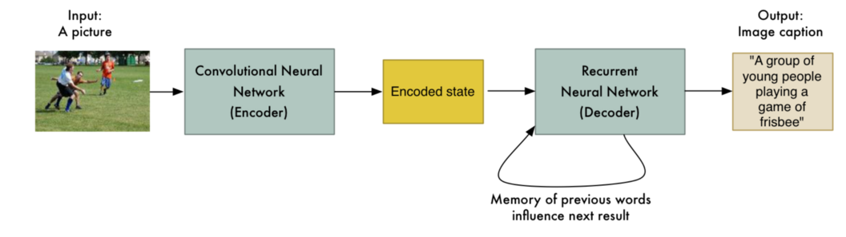
Machine Translation
Question and Answer
Image to Text ( Image Captioning)

Slide 18
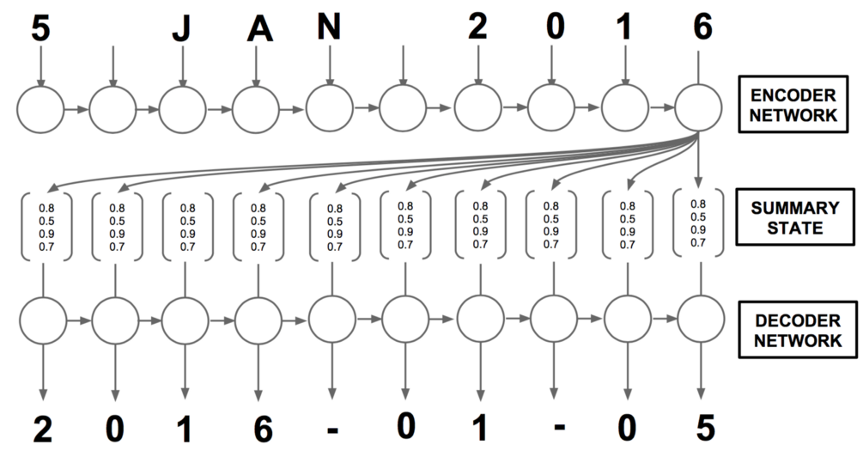
Machine Translation
RNN Encoder-Decoder
Cho, et al, “Learning phrase representations using RNN encoder-decoder for statistical machine translation”, EMNLP, 2014

Slide 19
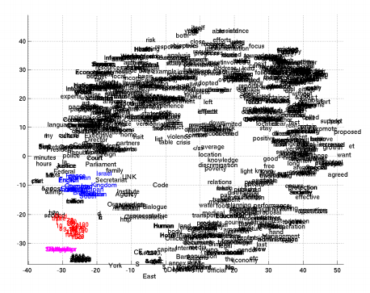
Machine Translation
RNN Encoder-Decoder

Slide 20
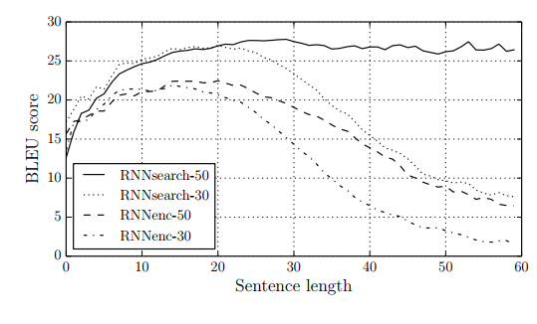
Machine Translation
RNN Encoder-Decoder
문제점 : 문장이 길어질 수록 Weight가 줄어들 가능성이 높아져서 정확도가 줄어듦

Slide 21
Machine Translation
RNN Encoder-Decoder
문제점 : 문장이 길어질 수록 Weight가 줄어들 가능성이 높아져서 정확도가 줄어듦
Fun
is
Learning
Machine
RNN
RNN
RNN
RNN
RNN
RNN
RNN
RNN
Sentence
Feature
Machine
Learning
is
Fun

Slide 22
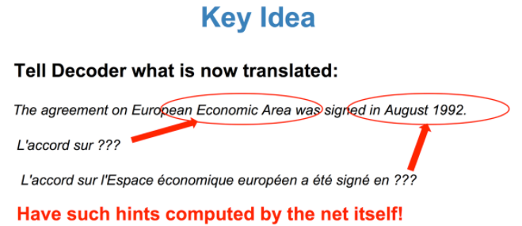
Machine Translation
RNN Encoder-Decoder + Attention
Cho, et al, “Neural Machine Translation by Jointly Learning to Align and Translate”, ICLR 2015
Why Attention?
중요한 것을 다시 한번 중요하다고 되새김질할 필요가 있음
Decoding 시 사용되는 Encoding 정보를 중요한 것에 Attention 할 수 있게 함으로써 더욱 Decoding을 잘 할 수 있게 됨

Slide 23
Machine Translation
RNN Encoder-Decoder + Attention
Machine
RNN
Weighted Sum
RNN
RNN
RNN
RNN
Machine
Learning
is
Fun

Slide 24
Machine Translation
RNN Encoder-Decoder + Attention
Learning
Machine
RNN
RNN
Weighted Sum
RNN
RNN
RNN
RNN
Machine
Learning
is
Fun

Slide 25
Machine Translation
RNN Encoder-Decoder + Attention
is
Learning
Machine
RNN
RNN
RNN
Weighted Sum
RNN
RNN
RNN
RNN
Machine
Learning
is
Fun

Slide 26
Machine Translation
RNN Encoder-Decoder + Attention
Fun
is
Learning
Machine
RNN
RNN
RNN
RNN
Weighted Sum
RNN
RNN
RNN
RNN
Machine
Learning
is
Fun

Slide 27
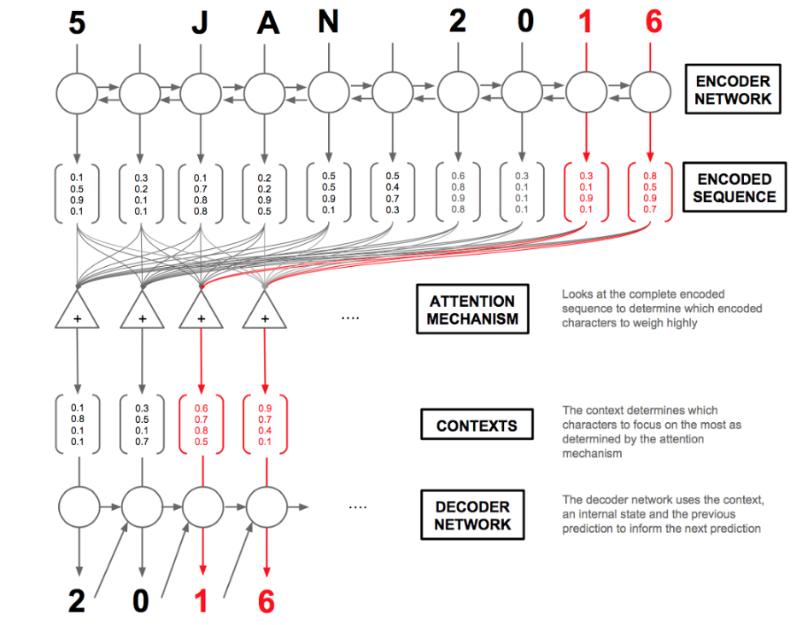
Machine Translation
RNN Encoder-Decoder + Attention

Slide 28
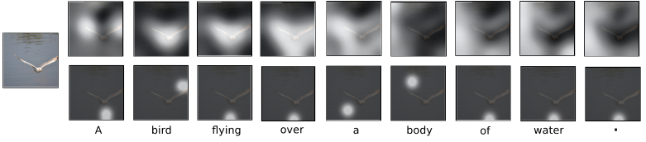
Attention Model
Attention Model
Hard attention
trainable by maximizing an approximate variational lower bound or equivalently by REINFORCE.
Soft attention
Differentiable model of attention(we can backpropagation!)
Soft →
Hard →

Slide 29
Attention Model
Attention Model
Soft attention
Target = Input의 일부분
Attention Model
Context(문맥)
Target = Input
의 각 Partition

Slide 30
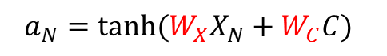
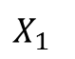
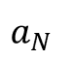
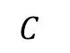
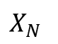
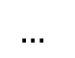
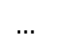
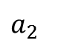
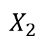
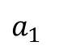
Attention Model
Attention Model
Soft attention 1: Input과 c를 Fusion하는 것을 학습
$$a_{1}$$
$$a_{2}$$
$$…$$
$$a_{N}$$
$$a_{N}=tanh⁡(W_{X}X_{N}+W_{C}C)$$
$$C$$
$$X_{1}$$
$$X_{2}$$
$$…$$
$$X_{N}$$
Target = Input
의 각 Partition

Slide 31
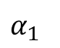
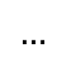
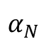
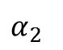
Attention Model
Attention Model
Soft attention 2: Fusion의 결과를 0~1사이의 Weights로 반환
$$α_{1}$$
$$α_{2}$$
$$…$$
$$α_{N}$$
Softmax
$$a_{1}$$
$$a_{2}$$
$$…$$
$$a_{N}$$
$$a_{N}=tanh⁡(W_{X}X_{N}+W_{C}C)$$
$$C$$
$$X_{1}$$
$$X_{2}$$
$$…$$
$$X_{N}$$

Slide 32
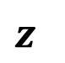
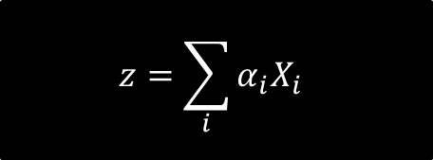
Attention Model
Attention Model
Soft attention 3: 학습된 Weights를 곱하여 Filtering된 Input을 출력
$$z$$
$$α_{1}$$
$$α_{2}$$
$$…$$
$$α_{N}$$
Softmax
$$z=\sum_{i}{α_{i}X_{i}}$$
$$a_{1}$$
$$a_{2}$$
$$…$$
$$a_{N}$$
$$C$$
$$X_{1}$$
$$X_{2}$$
$$…$$
$$X_{N}$$

Slide 33
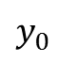
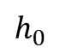

Attention Model
Attention Model
Soft attention + RNN
$$y_{0}$$
RNN
$$h_{1}$$
$$h_{0}$$
Input

Slide 34
Attention Model
Attention Model
Soft attention + RNN
$$y_{0}$$
RNN
$$h_{1}$$
$$h_{0}$$
Input
Attention Model
Context(문맥)
Input

Slide 35


Attention Model
Attention Model
Soft attention + RNN
$$y_{0}$$
$$y_{1}$$
RNN
RNN
$$h_{1}$$
$$h_{2}$$
$$h_{0}$$
Input
Attention Model
Context(문맥)
Input

Slide 36

Attention Model
Attention Model
Soft attention + RNN
$$y_{0}$$
$$y_{1}$$
$$y_{2}$$
RNN
RNN
RNN
$$h_{1}$$
$$h_{2}$$
$$h_{0}$$
Input
Attention Model
Attention Model
Context(문맥)
Input
Input

Slide 37
Attention Model
Attention Model
Machine
RNN
Weighted Sum
RNN
RNN
RNN
RNN
Machine
Learning
is
Fun

Slide 38
Attention Model
Attention Model
Learning
Machine
RNN
RNN
Weighted Sum
RNN
RNN
RNN
RNN
Machine
Learning
is
Fun

Slide 39
Attention Model
Attention Model
is
Learning
Machine
RNN
RNN
RNN
Weighted Sum
RNN
RNN
RNN
RNN
Machine
Learning
is
Fun

Slide 40
Attention Model
Attention Model
Fun
is
Learning
Machine
RNN
RNN
RNN
RNN
Weighted Sum
RNN
RNN
RNN
RNN
Machine
Learning
is
Fun

Slide 41

Case study
RnnSearch
Cho, et al, “Neural Machine Translation by Jointly Learning to Align and Translate”, ICLR 2015

Slide 42

Case study
RnnSearch
Decoder

Slide 43

Case study
RnnSearch
Attention model

Slide 44


Case study
RnnSearch
Illustration of the attention parameter

Slide 45


Case study
History of Image Captioning with RNN
CNN+RNN image Captioning
[1] Deep Visual-Semantic Alignments for Generating Image Descriptions, CVPR 2015, Karpathy
CNN+LSTM Image Captioning
[2] Show and Tell: A Neural Image Caption Generator, CVPR 2015, Vinyals
CNN + LSTM + Attention
Show, Attend and Tell: Neural Image Caption Generation with Visual Attention, ICML 2015, Xu

Slide 46

Case study
Show attend and tell
Image Captioning + Attention
Pooling된 CNN feature를 생성하여 문장으로 변환

Slide 47

Case study
Show attend and tell

Slide 48




Case study
Show attend and tell
Encoder : CNN
VGGnet pre-training
Image :
Decoder : LSTM
Caption :

Slide 49


Case study
Show attend and tell
Decoder : LSTM

Slide 50

Case study
Show attend and tell
Attention model

Slide 51
















Case study
Show attend and tell
Soft Attention model
$$α_{t1}$$
$$α_{t2}$$
$$…$$
$$α_{tL}$$
Softmax
$${\hat{z}}_{t}=\sum_{i}{{α_{ti}a}_{i}}$$
$$e_{t1}$$
$$e_{t2}$$
$$…$$
$$e_{tL}$$
$${\hat{z}}_{t}$$
$$h_{t−1}^{}$$
$$a_{1}$$
$$a_{2}$$
$$…$$
$$a_{L}$$

Slide 52

Case study
Show attend and tell
Result

Slide 53


Case study
Dual attention net (DAN)
Nam et al. “Dual Attention Networks for Multimodal Reasoning and Matching“, CVPR 2017

Slide 54













Case study
Dual attention net (DAN)
Attention Mechanisms
Visual Attention
$$α_{1}$$
$$α_{2}$$
$$…$$
$$α_{N}$$
Softmax
$$v^{(k)}=P^{(k)}\sum_{n}{α_{v,n}^{(k)}v_{n}}$$
$$h_{v, 1}^{(k)}$$
$$h_{v, 2}^{(k)}$$
$$…$$
$$h_{v, N}^{(k)}$$
$$v^{(k)}$$
$$m_{v}^{k−1}$$
$$v_{1}$$
$$v_{2}$$
$$…$$
$$v_{N}$$

Slide 55











Case study
Dual attention net (DAN)
Attention Mechanisms
Texture Attention
$$α_{1}$$
$$α_{2}$$
$$…$$
$$α_{T}$$
Softmax
$$v^{(k)}=\sum_{t}{α_{u,t}^{(k)}v_{t}}$$
$$h_{u, 1}^{(k)}$$
$$h_{u, 2}^{(k)}$$
$$…$$
$$h_{u, T}^{(k)}$$
$$u^{(k)}$$
$$m_{u}^{k−1}$$
$$u_{1}$$
$$u_{2}$$
$$…$$
$$u_{T}$$

Slide 56

Case study
Dual attention net (DAN)
Multimodal Reasoning (r-DAN)

Slide 57




Case study
Dual attention net (DAN)
Multimodal Reasoning (r-DAN)
Learning joint representation
Visual and textual attentions integrate features relevant to the answer

Slide 58

Case study
Dual attention net (DAN)
Multimodal Matching (m-DAN)

Slide 59




Case study
Dual attention net (DAN)
Multimodal Matching (m-DAN)
Learning a joint embedding space
Visual and textual attentions discover shared semantics between two modalities

Slide 60

Case study
Dual attention net (DAN)
Result (r-DAN)

Slide 61

Case study
Dual attention net (DAN)
Result (m-DAN)

Slide 62

Case study
Up-down attention for Image Captioning and VQA
Peter Anderson et al, “Bottom-Up and Top-Down Attention for Image Captioning and Visual Question Answering“, CVPR 2017

Slide 63

Case study
Up-down attention for Image Captioning and VQA
Bottom-Up Attention model with Faster R-CNN
In captioning and VQA, use only the feature vectors – not the predicted labels.

Slide 64



Case study
Up-down attention for Image Captioning and VQA
Overview of the proposed Image Captioning model
Attention Model Input을 LSTM의 결과 Vector로!

Slide 65




Case study
Up-down attention for Image Captioning and VQA
Overview of the proposed VQA model

Slide 66

Case study
Up-down attention for Image Captioning and VQA
Result – Image Captioning

Slide 67

Case study
Up-down attention for Image Captioning and VQA
Result – Visual Q&A

Slide 68
Thank you !!
Q & A

